Slide 1

Economics at UEA
More than a subject
Dr Emiliya Lazarova
Head of School of Economics

Slide 2

TODAY’S AGENDA
WHAT IS ECONOMICS?
WHAT MAKES ECONOMICS AT UEA SO SPECIAL?
WHAT ARE YOUR DEGREE CHOICES?
HOW WILL I BE SUPPORTED and ASSESSED?
WHAT LIES BEYOND YOUR DEGREE?

Slide 3

WHAT IS ECONOMICS?

Slide 4

WHAT IS ECONOMICS?
Economics is the study of how societies/firms/individuals use their resources …
… and of how societies/firms/individuals should use their resources …
… with all of the terms within this definition being (potentially) very broadly interpreted.
It is important to understand the diversity of economists’ specific interests and of the real world issues to which economics can be applied.

Slide 5

WHAT IS ECONOMICS?
I also, recently, asked each of my colleagues (teaching faculty in the School of Economics) to briefly describe a question or issue that is motivating them personally in their current work as economists …

Slide 6


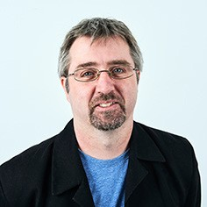


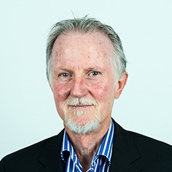


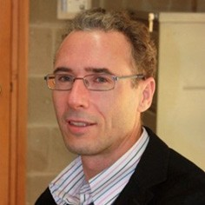
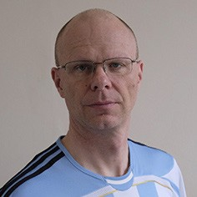


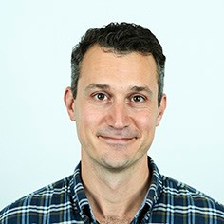

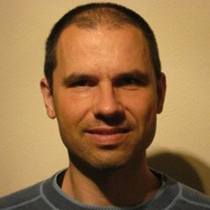

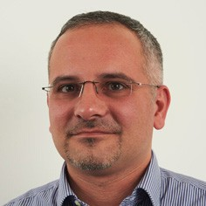


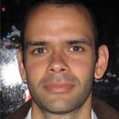
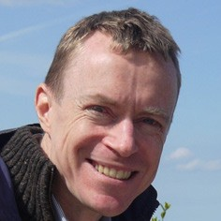

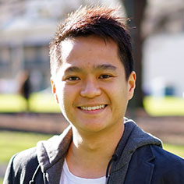
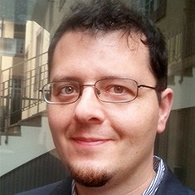

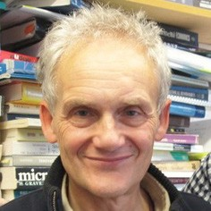
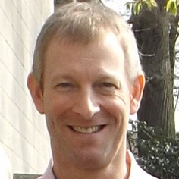

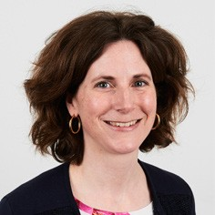

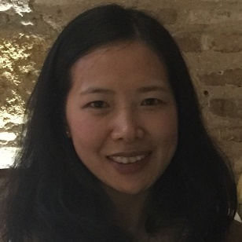

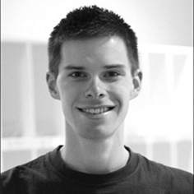


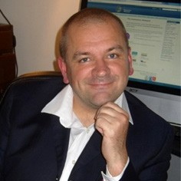
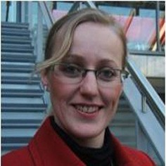
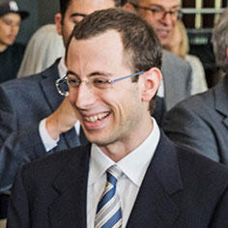
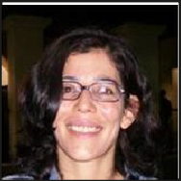

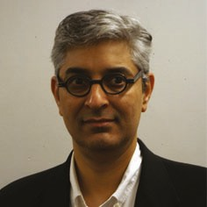

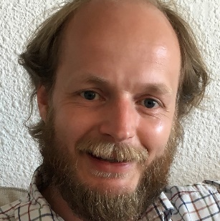
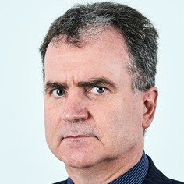
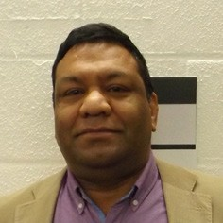


Slide 7



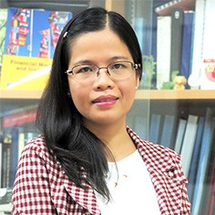
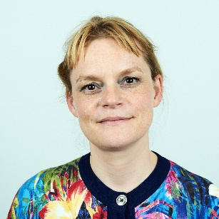
“I'm trying to show that a well-functioning market economy doesn't depend on people being either rational or self-interested. It enables people to cooperate in achieving whatever they happen to want.”
Professor Robert Sugden

Slide 8
“I’m interested in the way people operate collectively. What is the best way to motivate workers in teams? How do groups trade off fairness and efficiency when making joint decisions?”
Dr Anders Poulsen (Lecturer on Behavioural Economics)

Slide 9
“My motivation is to communicate a better, wider, understanding of how economic policy – decisions made by governments and central banks – directly affects each of us in our everyday lives.”
Dr James Watson (Lecturer on Intermediate Macroeconomics)

Slide 10
“My work is showing that fiscal policy can have different impacts on men and women. I am trying to understand and explain how taxation and government spending can serve to reduce or amplify gender-based inequalities.”
Dr Ruth Badru (Lecturer on European Economy and on Further Econometrics and Data Analysis)

Slide 11
“I am fascinated by the relationship between technological progress and employment. Will a specific new technology create jobs, or destroy jobs? And can education change the outcome that arises?”
Dr Fabio Arico (Lecturer on History of Economic Thought)

Slide 12
“I’m interested in the relationships between natural resource wealth, economic development, and human conflict. Can institutions and policies change these relationships?”
Dr Christa Brunnschweiler (Lecturer on Government, Welfare and Policy)

Slide 13
“I’m trying to explore the full consequences of migration on individuals, families, and the economy around the world.”
Dr Liliana Harding (Lecturer on Labour Economics)

Slide 14
“I am interested in understanding how climate change policy and technical change interact to affect economic well being.”
Dr Corrado Di Maria (Lecturer on Economics of the Environment)

Slide 15
“In 2017, the price of one bitcoin rose from $959 to $18,940. I’m using financial econometric methods to explain why such “bubbles” occur, and to generate useable price forecasts when they do.”
Professor Peter Moffatt

Slide 16
“I’m intrigued by the business strategies of the digital economy. Are software updates more about fixing bugs, or stimulating demand? What do we learn from the different behaviours of the Google Play and iTunes platforms?”
Dr Franco Mariuzzo (Lecturer on Industrial Organisation and Business Strategies and on Competition in the Digital Age)

Slide 18

WHAT MAKES ECONOMICS AT UEA SO SPECIAL?

Slide 19


OUR REPUTATION FOR EXCELLENCE
The School of Economics at UEA is globally respected for its research and for the quality of its academic programmes.
The School is known particularly for its world leading work in Behavioural Economics, and also for its work in competition policy, economic theory, finance and applied econometrics.

Slide 20


Top 10
For Research Outputs in Economics - REF 2014

Slide 21

Top 10
For Overall Student Satisfaction in Economics - NSS 2020

Slide 22

Top 10
For Economics - Guardian University League Table 2020

Slide 23

Behavioural Economics (An Example)
Imagine I propose to flip a coin.
If it is tails you lose CZK500. If it is heads you win CZK ??.
Tell me how much you would have to gain on winning (if it is heads) in order for this gamble to be acceptable to you?
(CZK400? CZK500? CZK600? CZK700? … Any amount – you choose!)

Slide 24
Behavioural Economics (An Example)
“Risk Aversion”
(Conventional Economics)
“Utility”
Reference point
Money

Slide 25
Behavioural Economics (An Example)
“Risk Aversion”
(Conventional Economics)
“Loss Aversion”
(Behavioural Economics)
“Utility”
“Value”
Reference point
Money
Reference point
Money

Slide 26
Behavioural Economics (An Example)
“Risk Aversion”
(Conventional Economics)
“Loss Aversion”
(Behavioural Economics)
“Utility”
“Value”
Reference point
Money
Reference point
Money

Slide 27

Loss Aversion
Economists now use the concept of “loss aversion” to explain real world phenomena.
For example: understanding the “equity premium puzzle”.
And policy-makers use it to effect social change.
For example: reducing the use of plastic bags, and disposable coffee cups!

Slide 28
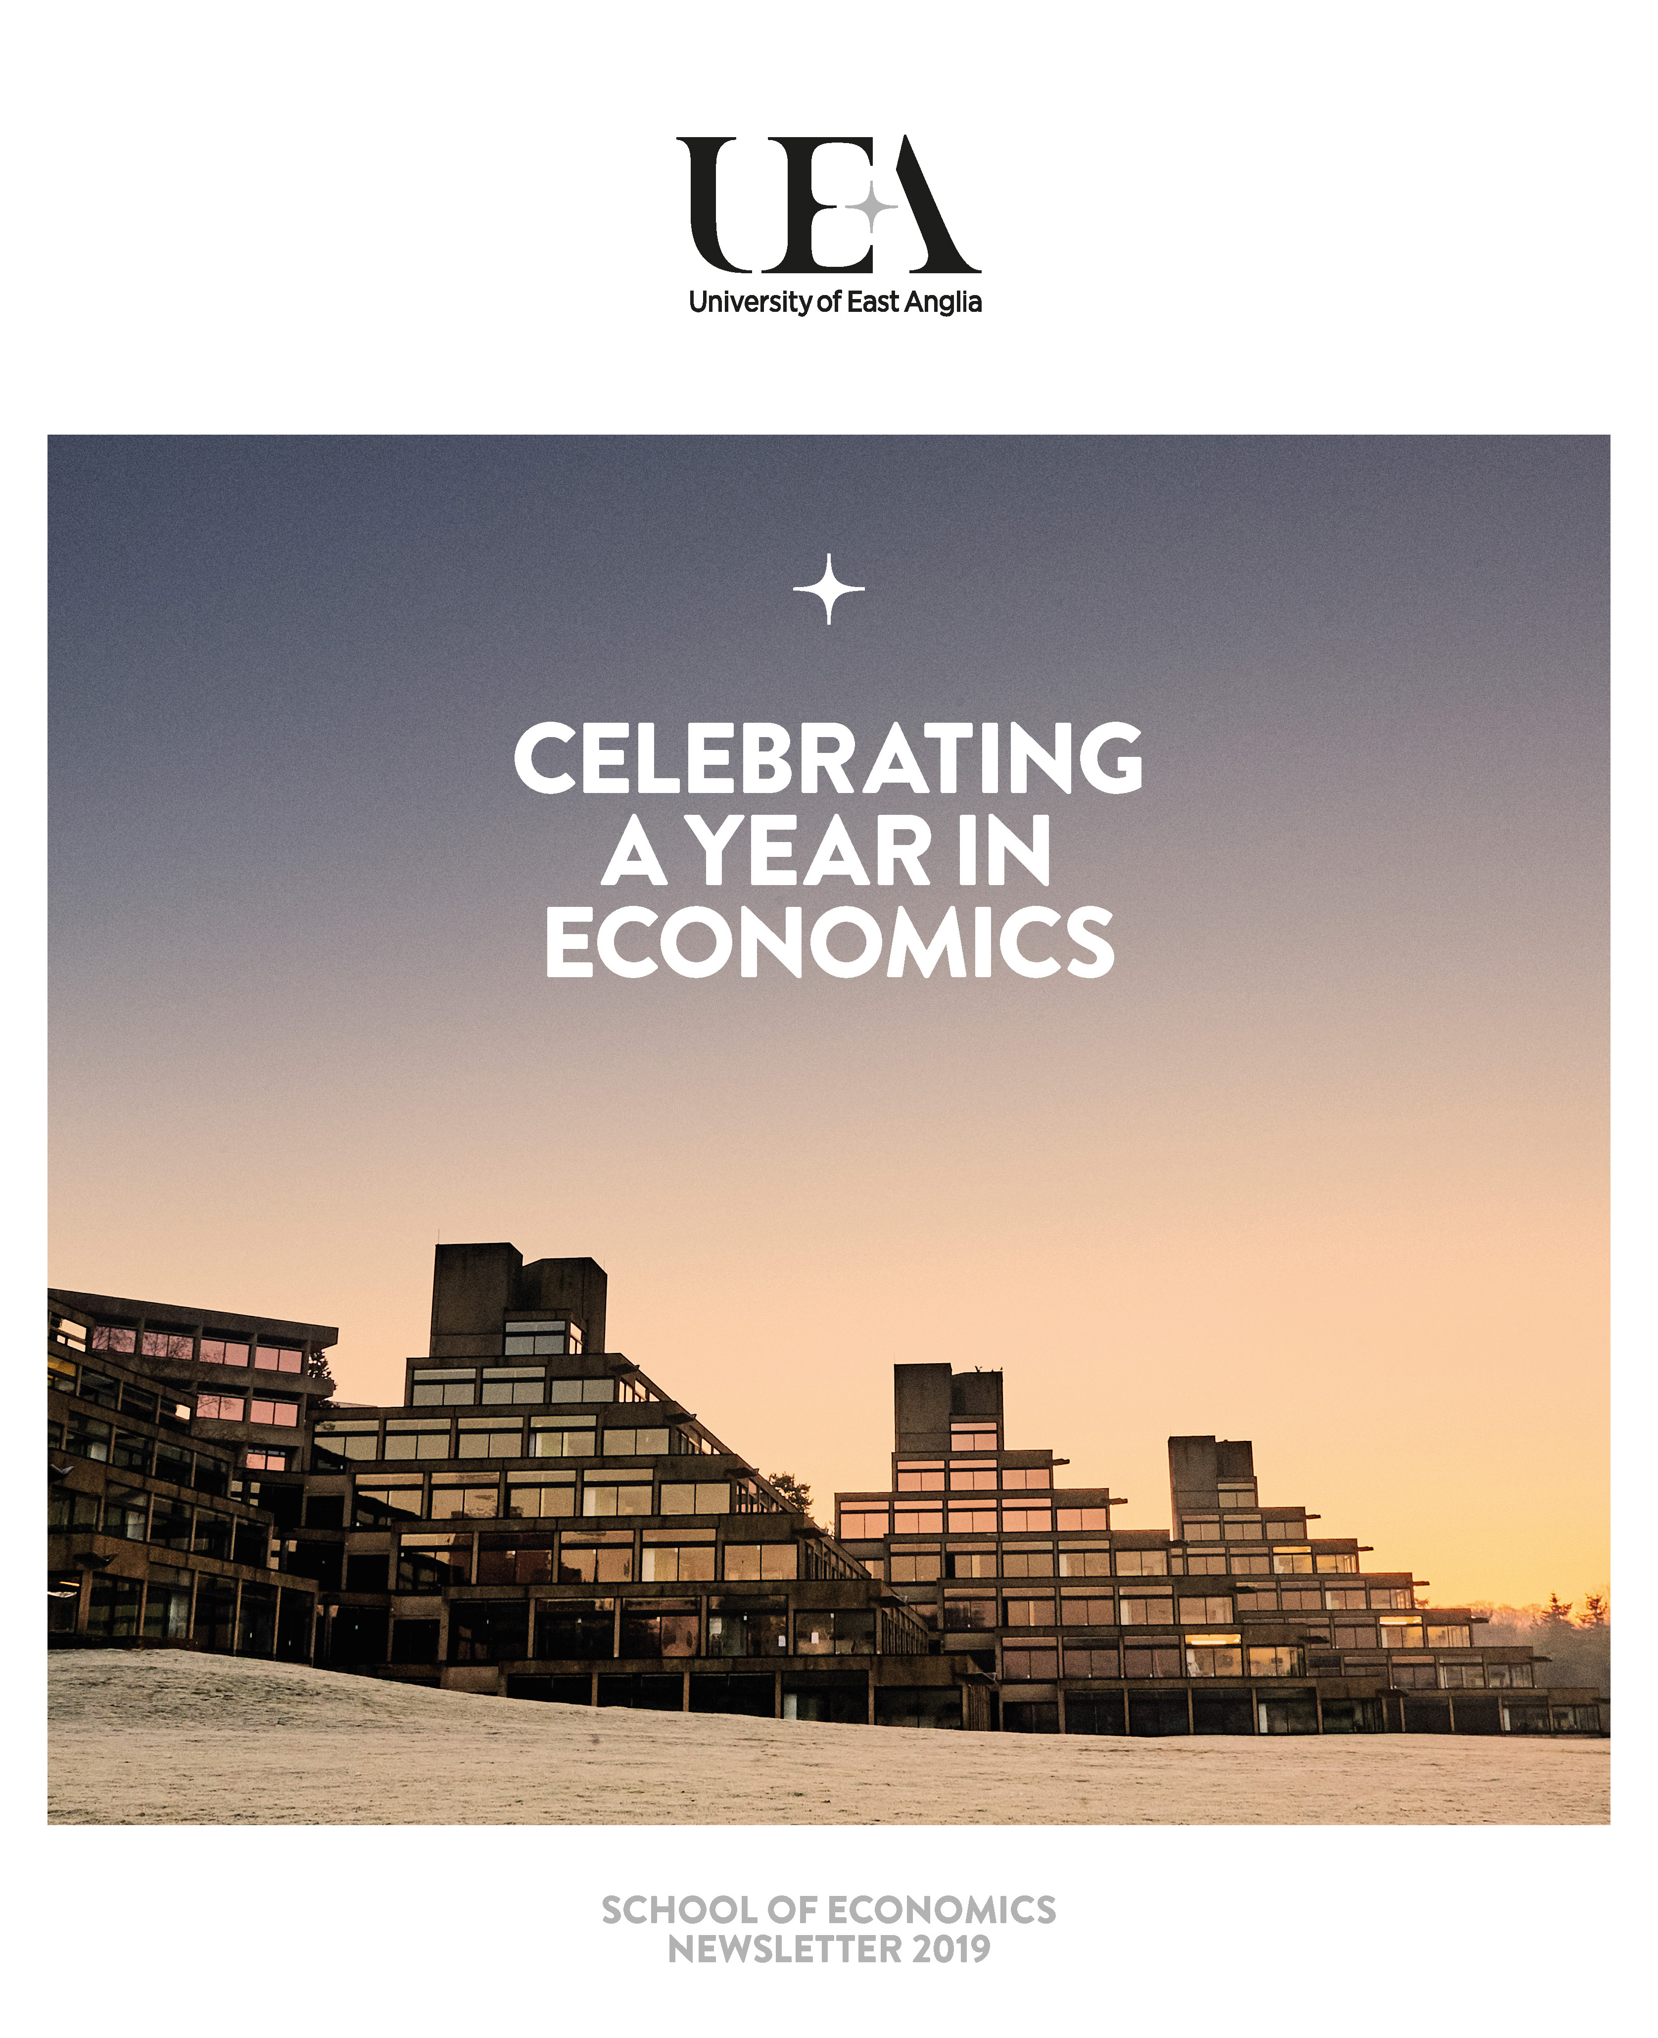
COMMITMENT TO
SUCCESS & COMMUNITY
Students in ECO build relationships that last a lifetime.
The School is diverse and friendly.
Staff offices open directly to student study spaces.
We have a vibrant, student-run Economics Society, Essay Journal, and Student-Staff Liaison Committee.
And a busy schedule of in-school social and sporting activities.

Slide 29


EMPLOYABILITY EVENTS – ECO Spring Semester

Slide 30

WHAT are OUR MSc DEGREE CHOICES for YOU?

Slide 31


Slide 32


Slide 33



Slide 34


Slide 35

Academic and Professional Programmes
Core modules for the programmes
Economic Theory: Microeconomics
Economic Theory: Macroeconomics
Econometric Theory
Applied Econometrics
Financial Econometric Theory
Financial Mathematics
Behavioural and Experimental Economics (theory)
Behavioural and Experimental Economics (project)
International Finance
Environmental and Natural Resource Economics
Industrial Organization and Competition Economics
Empirical Industrial Organization and Competition Policy
Finance
Microeconomics of Development
Macroeconomics of Development
Dissertation Module

Slide 36
Academic and Professional Programmes
MSc Competition Economics and Policy
Economic Theory: Microeconomics
Economic Theory: Macroeconomics
Econometric Theory
Applied Econometrics
Financial Econometric Theory
Financial Mathematics
Behavioural and Experimental Economics (theory)
Behavioural and Experimental Economics (project)
International Finance
Environmental and Natural Resource Economics
Industrial Organization and Competition Economics
Empirical Industrial Organization and Competition Policy
Finance
Microeconomics of Development
Macroeconomics of Development
Dissertation Module

Slide 37
Academic and Professional Programmes
MSc Economics
Economic Theory: Microeconomics
Economic Theory: Macroeconomics
Econometric Theory
Applied Econometrics
Financial Econometric Theory
Financial Mathematics
Behavioural and Experimental Economics (theory)
Behavioural and Experimental Economics (project)
International Finance
Environmental and Natural Resource Economics
Industrial Organization and Competition Economics
Empirical Industrial Organization and Competition Policy
Finance
Microeconomics of Development
Macroeconomics of Development
Dissertation Module

Slide 38
Applied Training Programmes
Core modules for the programmes
Economic Concepts
Econometric Methods
International Trade
Financial Econometrics
International Relations Theory
Financial Markets
Multinational Firms
Money and Banking
International Finance
Risk Management and Trading
Economics of the Mass Media
Financial Mathematics
Finance
Environmental and Natural Resource Economics
Politics and Media
Applied Econometrics
Programming and Analytics for Behavioural Economics
Data Mining
Consumer Behaviour
Dissertation Module

Slide 39
Applied Training Programmes
MSc Money Banking and Capital Markets
Economic Concepts
Econometric Methods
International Trade
Financial Econometrics
International Relations Theory
Financial Markets
Multinational Firms
Money and Banking
International Finance
Risk Management and Trading
Economics of the Mass Media
Financial Mathematics
Finance
Environmental and Natural Resource Economics
Politics and Media
Applied Econometrics
Programming and Analytics for Behavioural Economics
Data Mining
Consumer Behaviour
Dissertation Module

Slide 40
Applied Training Programmes
MSc International Business Economics
Economic Concepts
Econometric Methods
International Trade
Financial Econometrics
International Relations Theory
Financial Markets
Multinational Firms
Money and Banking
International Finance
Risk Management and Trading
Economics of the Mass Media
Financial Mathematics
Finance
Environmental and Natural Resource Economics
Politics and Media
Applied Econometrics
Programming and Analytics for Behavioural Economics
Data Mining
Consumer Behaviour
Visualization
Dissertation Module

Slide 41

How will I be supported?

Slide 42

Individual Support
Module Teaching Teams
Formative Assessments
Office Hours
School Support Tutors
Support Sessions
One-to-one Support Meetings
School Advisers
Your Personal Adviser
School Senior Adviser
Disability Officer; Women’s Adviser
Employability Team

Slide 43
Individual Support
University Level
Student Support Service
Learning Enhancement Team

Slide 44

How will I
be assessed?

Slide 45
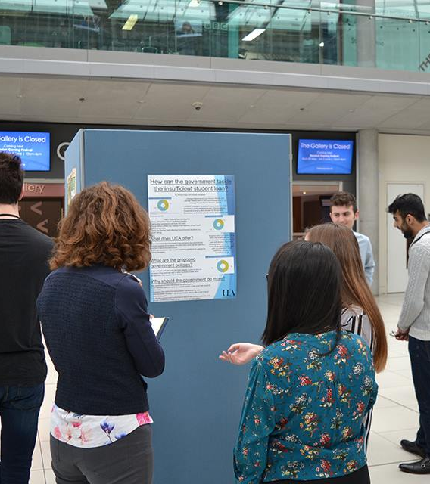
Assessment Types
Exams
Coursework:
  Essays
  Seminar Presentations
  Computer Tests
  Research Projects
  (Public) Poster Presentations
  (Optional) Dissertation

Slide 46

WHAT LIES BEYOND YOUR DEGREE?

Slide 47

WHY STUDY ECONOMICS?
Studying Economics provides students with a unique set of both analytical and interpersonal skills, highly demanded by employers in a wide range of roles and sectors.
This builds very strong career prospects.

Slide 48
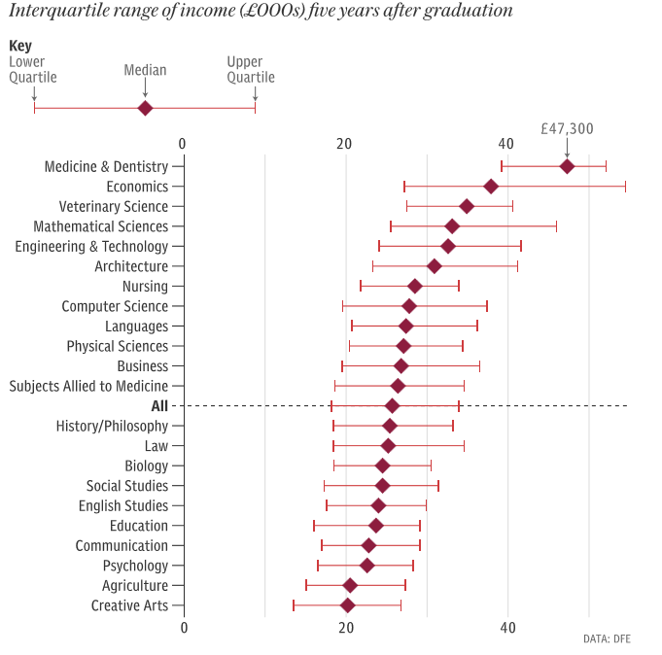
EARNINGS FIVE YEARS AFTER GRADUATION
Economics
Business
All degrees
Source: Telegraph, June 2018
Data: Department for Education, June 2018

Slide 49
Does having an MSc degree pay?
We use DLHE( 2014-2016) that track UEA graduates 6 mons after graduation
We see that PGT graduates earn about 22% more than UG graduate
We see that PGT graduates are 13.8% more likely to secure a professional job (86.04% versus72.29%)

Slide 50

EMPLOYABILITY DEVELOPMENT
Employability embedded within the curriculum
Employability activities and events
Work experience

Slide 51

EMPLOYABILITY IN THE CURRICULUM
It open the opportunity to work on a project in collaboration with a non-academic partner – a business, charity, public authority
Application of economics to real-world problems
The structure and format of the report can be tailored to the individual partner requirements
May be used as a stepping stone for future work placement.

Slide 52

EMPLOYABILITY ACTIVITIES
We provide a series of events and activities tailored for Economics students:
Regular Alumni / Employers Events
Employability Skills Workshops (applications, CVs, psychometric tests, interviews, etc.)
Subsidies for Career Conferences / Study Trips and Competitions

Slide 53

CAREERS CENTRE
Working closely with the UEA Careers Centre, we make sure that our students are well informed about the most relevant career activities and opportunities across the UEA.
Employer Fairs and Talks
Advice and Workshops on CVs / Cover Letters / Applications
Mock interviews / Assessment centres / Aptitude tests
Career Coaching & Mentoring
Students’ Enterprise
Plenty of Online Resources

Slide 54
WHERE DO OUR RECENT GRADUATES WORK?
2MC
Risk & Compliance Consultant
Amazon
Regional Manager
Aon
Business Performance Consultant
Barclays
Compliance Analyst
BDO
Senior Associate Tax
BNP Paribas
Securitisation Analyst
Capco
Associate Consultant
Charles Rivers Associates
Associate
Competition and Markets Authority
Economics Adviser
Crowe UK
Accountant
Deloitte
Audit Associate
Department for Business Energy & Industrial Strategy
Policy Advisor
Department for International Development
Graduate Economists
Ernst & Young
Strategy Consultant
FDM Group
Data Analyst
Fitch Ratings
Associate Analyst
Frontier Economics
Economic Consultant
Grant Thornton
Advisory Associate
Handelsbanken
Account Manager Support
HMRC
VAT Tax Specialist
HM Treasury
Assistant Economist
HSBC
Private Bank Settlement Officer
IG
Trader
KPMG
Chartered Accountant Trainee
Merkle Group Inc.
Digital Data Analyst
Morgan Stanley
Sales & Distribution Analyst
MBU Capital
Investment Banker
Office of National Statistics
Assistant Economist
OfCom
Economics Advisor
OfWat
Associate Analyst
PwC
Data Analyst
Price Bailey
Trainee Accountant
RBS
Graduate Financial Analyst
RSM
Chartered Accountant
Santander
Investment Banking Analyst
Sky
Econometrician
Uber
Head of Low Cost Products

Slide 55
GOVERNMENT & REGULATORS
2MC
Risk & Compliance Consultant
Amazon
Regional Manager
Aon
Business Performance Consultant
Barclays
Compliance Analyst
BDO
Senior Associate Tax
BNP Paribas
Securitisation Analyst
Capco
Associate Consultant
Charles Rivers Associates
Associate
Competition and Markets Authority
Economics Adviser
Crowe UK
Accountant
Deloitte
Audit Associate
Department for Business Energy & Industrial Strategy
Policy Advisor
Department for International Development
Graduate Economists
Ernst & Young
Strategy Consultant
FDM Group
Data Analyst
Fitch Ratings
Associate Analyst
Frontier Economics
Economic Consultant
Grant Thornton
Advisory Associate
Handelsbanken
Account Manager Support
HMRC
VAT Tax Specialist
HM Treasury
Assistant Economist
HSBC
Private Bank Settlement Officer
IG
Trader
KPMG
Chartered Accountant Trainee
Merkle Group Inc.
Digital Data Analyst
Morgan Stanley
Sales & Distribution Analyst
MBU Capital
Investment Banker
Office of National Statistics
Assistant Economist
OfCom
Economics Advisor
OfWat
Associate Analyst
PwC
Data Analyst
Price Bailey
Trainee Accountant
RBS
Graduate Financial Analyst
RSM
Chartered Accountant
Santander
Investment Banking Analyst
Sky
Econometrician
Uber
Head of Low Cost Products

Slide 56
BANKING, INVESTMENT & FINANCE
2MC
Risk & Compliance Consultant
Amazon
Regional Manager
Aon
Business Performance Consultant
Barclays
Compliance Analyst
BDO
Senior Associate Tax
BNP Paribas
Securitisation Analyst
Capco
Associate Consultant
Charles Rivers Associates
Associate
Competition and Markets Authority
Economics Adviser
Crowe UK
Accountant
Deloitte
Audit Associate
Department for Business Energy & Industrial Strategy
Policy Advisor
Department for International Development
Graduate Economists
Ernst & Young
Strategy Consultant
FDM Group
Data Analyst
Fitch Ratings
Associate Analyst
Frontier Economics
Economic Consultant
Grant Thornton
Advisory Associate
Handelsbanken
Account Manager Support
HMRC
VAT Tax Specialist
HM Treasury
Assistant Economist
HSBC
Private Bank Settlement Officer
IG
Trader
KPMG
Chartered Accountant Trainee
Merkle Group Inc.
Digital Data Analyst
Morgan Stanley
Sales & Distribution Analyst
MBU Capital
Investment Banker
Office of National Statistics
Assistant Economist
OfCom
Economics Advisor
OfWat
Associate Analyst
PwC
Data Analyst
Price Bailey
Trainee Accountant
RBS
Graduate Financial Analyst
RSM
Chartered Accountant
Santander
Investment Banking Analyst
Sky
Econometrician
Uber
Head of Low Cost Products

Slide 57
BIG 4 and ACCOUNTING
2MC
Risk & Compliance Consultant
Amazon
Regional Manager
Aon
Business Performance Consultant
Barclays
Compliance Analyst
BDO
Senior Associate Tax
BNP Paribas
Securitisation Analyst
Capco
Associate Consultant
Charles Rivers Associates
Associate
Competition and Markets Authority
Economics Adviser
Crowe UK
Accountant
Deloitte
Audit Associate
Department for Business Energy & Industrial Strategy
Policy Advisor
Department for International Development
Graduate Economists
Ernst & Young
Strategy Consultant
FDM Group
Data Analyst
Fitch Ratings
Associate Analyst
Frontier Economics
Economic Consultant
Grant Thornton
Advisory Associate
Handelsbanken
Account Manager Support
HMRC
VAT Tax Specialist
HM Treasury
Assistant Economist
HSBC
Private Bank Settlement Officer
IG
Trader
KPMG
Chartered Accountant Trainee
Merkle Group Inc.
Digital Data Analyst
Morgan Stanley
Sales & Distribution Analyst
MBU Capital
Investment Banker
Office of National Statistics
Assistant Economist
OfCom
Economics Advisor
OfWat
Associate Analyst
PwC
Data Analyst
Price Bailey
Trainee Accountant
RBS
Graduate Financial Analyst
RSM
Chartered Accountant
Santander
Investment Banking Analyst
Sky
Econometrician
Uber
Head of Low Cost Products

Slide 58
CONSULTANCIES
2MC
Risk & Compliance Consultant
Amazon
Regional Manager
Aon
Business Performance Consultant
Barclays
Compliance Analyst
BDO
Senior Associate Tax
BNP Paribas
Securitisation Analyst
Capco
Associate Consultant
Charles Rivers Associates
Associate
Competition and Markets Authority
Economics Adviser
Crowe UK
Accountant
Deloitte
Audit Associate
Department for Business Energy & Industrial Strategy
Policy Advisor
Department for International Development
Graduate Economists
Ernst & Young
Strategy Consultant
FDM Group
Data Analyst
Fitch Ratings
Associate Analyst
Frontier Economics
Economic Consultant
Grant Thornton
Advisory Associate
Handelsbanken
Account Manager Support
HMRC
VAT Tax Specialist
HM Treasury
Assistant Economist
HSBC
Private Bank Settlement Officer
IG
Trader
KPMG
Chartered Accountant Trainee
Merkle Group Inc.
Digital Data Analyst
Morgan Stanley
Sales & Distribution Analyst
MBU Capital
Investment Banker
Office of National Statistics
Assistant Economist
OfCom
Economics Advisor
OfWat
Associate Analyst
PwC
Data Analyst
Price Bailey
Trainee Accountant
RBS
Graduate Financial Analyst
RSM
Chartered Accountant
Santander
Investment Banking Analyst
Sky
Econometrician
Uber
Head of Low Cost Products

Slide 59
OTHER
2MC
Risk & Compliance Consultant
Amazon
Regional Manager
Aon
Business Performance Consultant
Barclays
Compliance Analyst
BDO
Senior Associate Tax
BNP Paribas
Securitisation Analyst
Capco
Associate Consultant
Charles Rivers Associates
Associate
Competition and Markets Authority
Economics Adviser
Crowe UK
Accountant
Deloitte
Audit Associate
Department for Business Energy & Industrial Strategy
Policy Advisor
Department for International Development
Graduate Economists
Ernst & Young
Strategy Consultant
FDM Group
Data Analyst
Fitch Ratings
Associate Analyst
Frontier Economics
Economic Consultant
Grant Thornton
Advisory Associate
Handelsbanken
Account Manager Support
HMRC
VAT Tax Specialist
HM Treasury
Assistant Economist
HSBC
Private Bank Settlement Officer
IG
Trader
KPMG
Chartered Accountant Trainee
Merkle Group Inc.
Digital Data Analyst
Morgan Stanley
Sales & Distribution Analyst
MBU Capital
Investment Banker
Office of National Statistics
Assistant Economist
OfCom
Economics Advisor
OfWat
Associate Analyst
PwC
Data Analyst
Price Bailey
Trainee Accountant
RBS
Graduate Financial Analyst
RSM
Chartered Accountant
Santander
Investment Banking Analyst
Sky
Econometrician
Uber
Head of Low Cost Products

Slide 60
Emiliya Lzarova: E.Lazarova@uea.ac.uk

